Slide 1

Chapter 7： DC-DC Switch-Mode Converters:
7-1 Introduction
7-2 Control of dc-dc Converters
7-3 Step-Down (Buck) Converter
7-4 Step-Up (Boost) Converter
7-5 Buck-Boost Converter
7-6 Cuk dc-dc Converter
7-7 Full Bridge dc-dc Converter
7-8 dc-dc Converter Comparison

Slide 2
7-5 BUCK-BOOST CONVERTER
7-5 BUCK-BOOST CONVERTER
Applications: Buck-Boost converter is mainly used in regulated dc power supplies, where a negative-polarity output voltage may be desired with respect to the common terminal of the input voltage, and the output voltage can be either higher or lower than the input voltage.
i_{d}
i_{D}
+
V_{d}
-
D
+
v_{L}
-
-
V_{o}
+
i_{L}
C
R
L
i_{o}

Slide 3
7-5 BUCK-BOOST CONVERTER
7-5-1 continuous-conduction mode ☆
i_{d}
i_{D}
+
V_{d}
-
D
+
v_{L}
-
i_{L}
-
V_{o}
+
1 Operation principle
C
R
L
(1) Turning on the switch applies the voltage V_{d} across the inductor, v_{L}=V_{d}, and i_{L} linearly ramps up, increasing the enery in the inductor.
i_{o}
v_{L}
V_{d}
(b)
t
(-V_{o})
T_{s}
i_{L}
I_{L}=(I_{d}+I_{o})
(2) turning off the switch results in the inductor current flowing through the diode, some of the stored energy is transferred to the output stage.
(c)
0
t
t_{on}
t_{off}
i_{d}
(d)
0
t
i_{D}
(e)
t
0

Slide 4
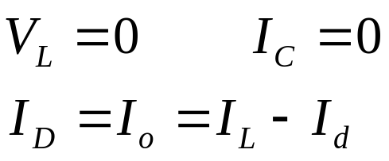
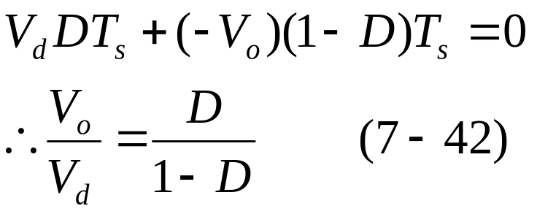
7-5 BUCK-BOOST CONVERTER
2 Steady-state analysis:
i_{d}
i_{D}
In the dc steady state:
+
V_{d}
-
D
+
v_{L}
-
i_{L}
-
V_{o}
+
C
R
L
i_{o}
v_{L}
V_{d}
(b)
t
(-V_{o})
T_{s}
i_{L}
I_{L}=(I_{d}+I_{o})
(c)
0
t
t_{on}
t_{off}
i_{d}
(d)
V_{o} can be controlled by varying the duty ratio D.
0
t
i_{D}
(e)
t
0

Slide 5
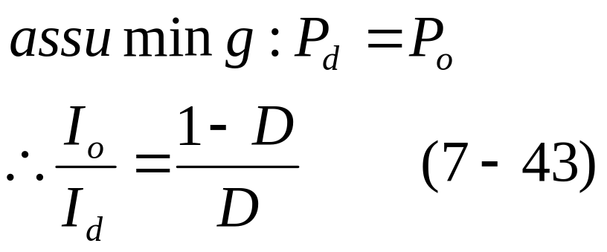
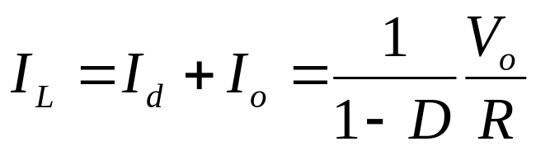
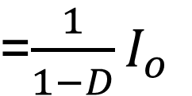
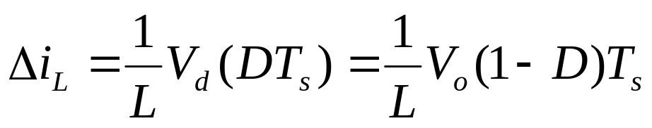
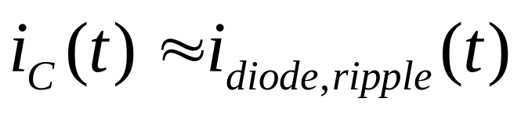
7-5 BUCK-BOOST CONVERTER
i_{d}
i_{D}
+
V_{d}
-
D
+
v_{L}
-
i_{L}
-
V_{o}
+
C
R
L
i_{o}
v_{L}
V_{d}
(b)
t
(-V_{o})
T_{s}
i_{L}
I_{L}=(I_{d}+I_{o})
(c)
0
t
t_{on}
t_{off}
i_{d}
(d)
0
t
i_{D}
(e)
t
0

Slide 6
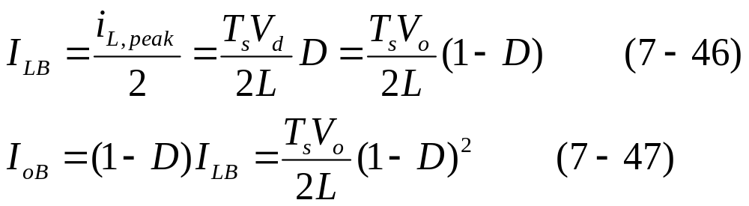
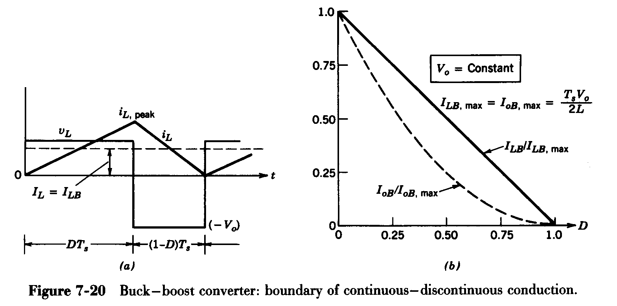
7-5-2 Boundary between continuous and discontinuous-conduction mode

Slide 7
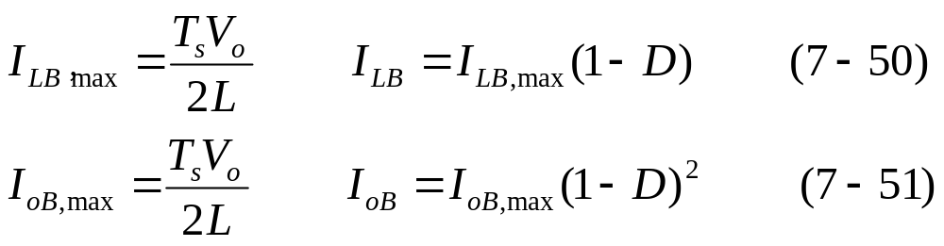
7-5-2 Boundary between continuous and discontinuous-conduction mode
For a constant V_{o}
The maximum values of I_{LB} and I_{oB} occurs at D=0.

Slide 8
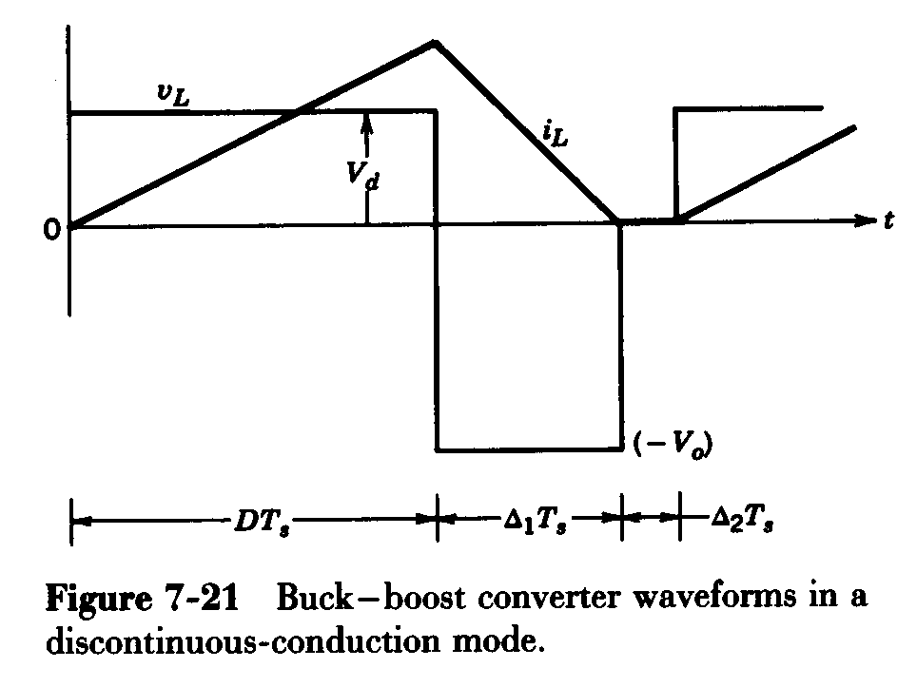
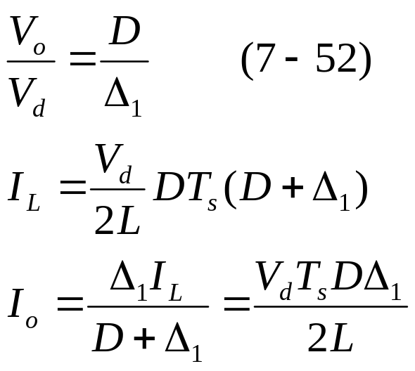
7-5 BUCK-BOOST CONVERTER
7-5-3 discontinuous-conduction mode
This occurs at light loads

Slide 9
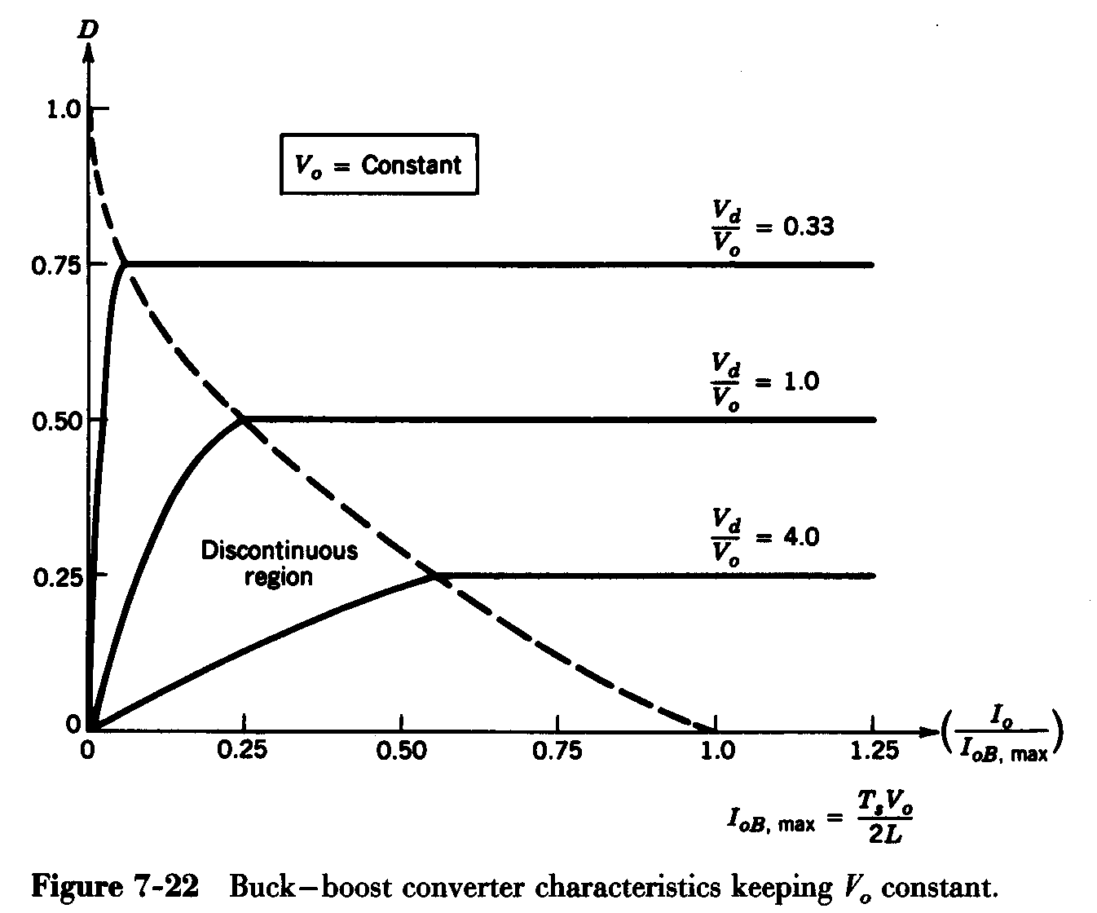
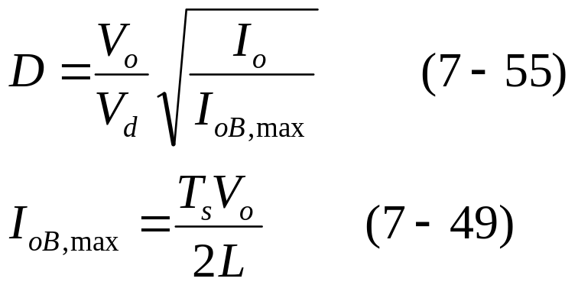
7-5 BUCK-BOOST CONVERTER
Step-Up DC-DC Converter: Limits of Cont./Discont. Conduction
For a constant V_{o}
The output voltage is held constant

Slide 10
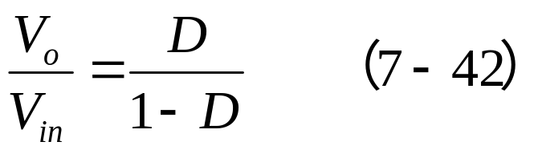
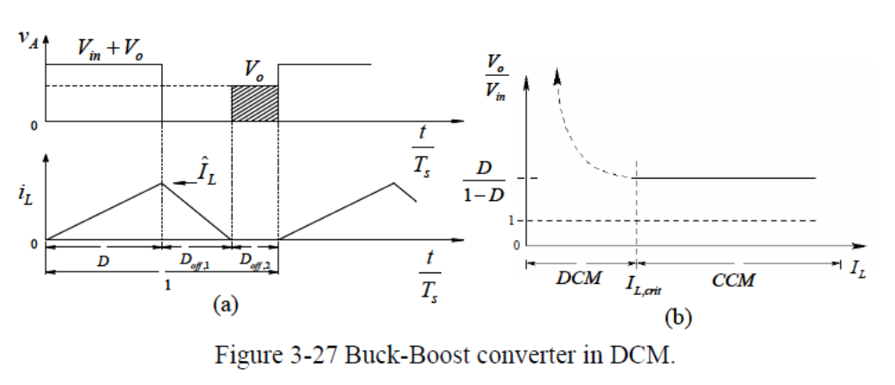
7-5 BUCK-BOOST CONVERTER
Buck-Boost converter: voltage transfer ratio
The voltage conversion ratio of Buck-Boost converters operating in CCM depends on D, but is independent of the output load. If the output load decreases to the extent that i_{L} becomes discontinuous (DCM), the relationship (7-42) is no longer valid.
Which one will have higher output voltage? CCM or DCM?

Slide 11
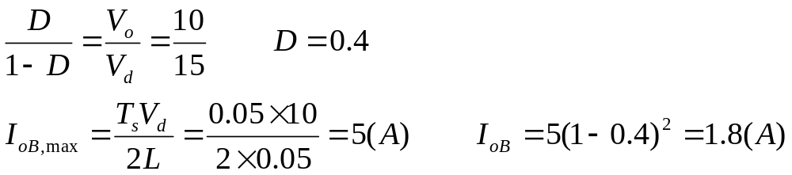
7-5 BUCK-BOOST CONVERTER
Example 7-2
In a buck-boost converter operating at 20kHz, L=0.05mH. The output capacitor C is sufficient large and V_{d}=15V. The output is to be regulated at 10V and the converter is supplying a load of 10W. Calculate the duty ratio D.
Solution
In this example, I_{o}=10/10=1A. Initially, the mode of conduction is unknown. Assuming the current to be at the edge of continuous conduction:

Slide 12
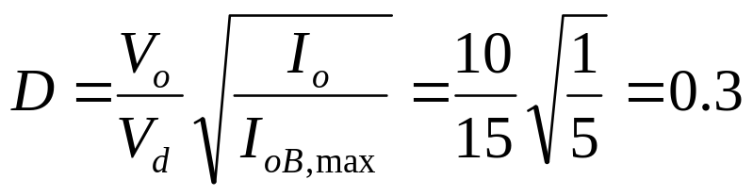
7-5 BUCK-BOOST CONVERTER
Solution
Since I_{o}=1A < I_{oB}, the current conduction is discontinuous.
Therefore:

Slide 13
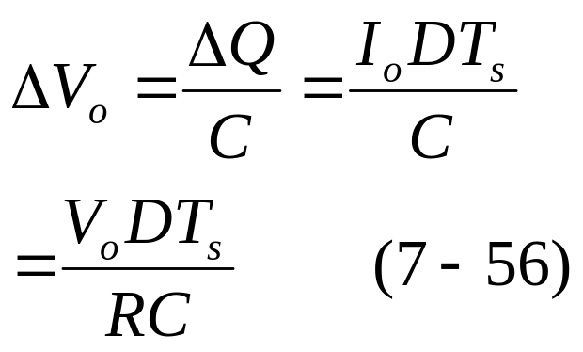
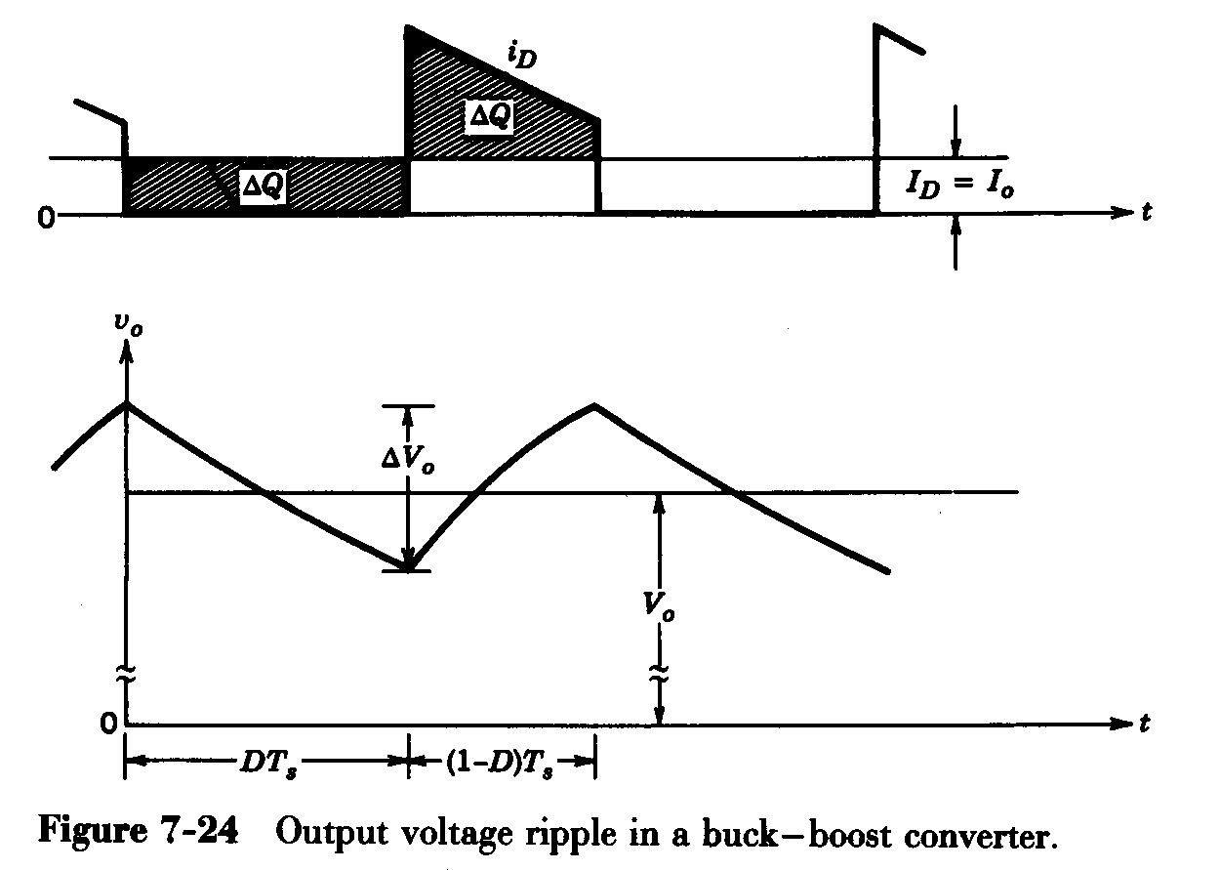
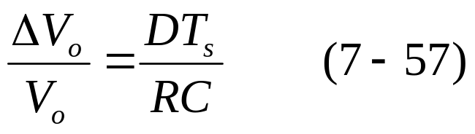
7-5 BUCK-BOOST CONVERTER
7-5-5 output voltage ripple
!! For a continuous-conduction mode
The ripple is dependent of the output load power.

Slide 14
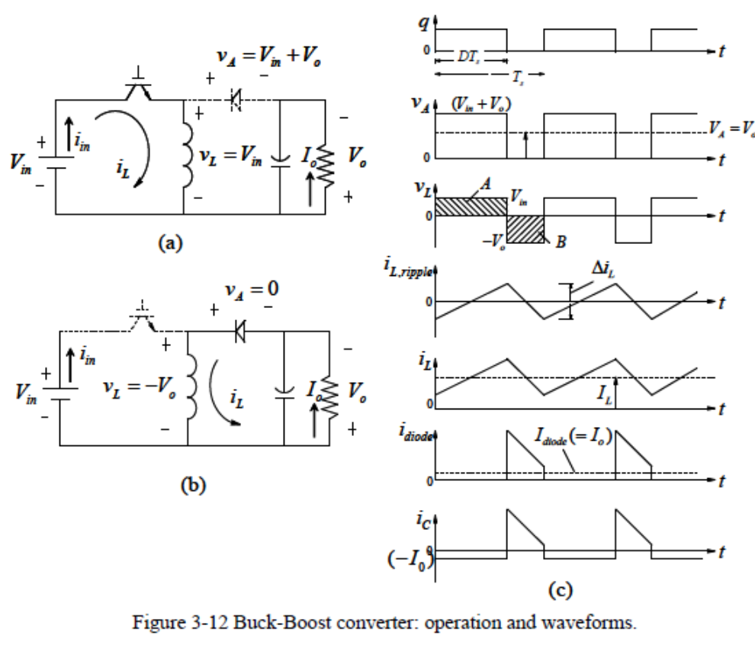
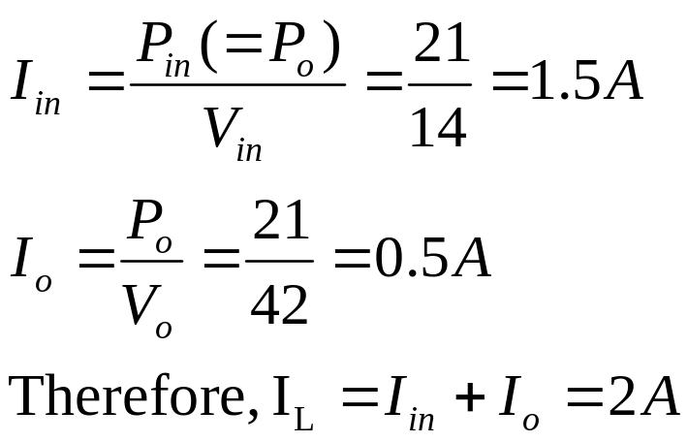
7-5 BUCK-BOOST CONVERTER
Example 7-C A Buck-Boost converter is operating in dc steady state under the following conditions: V_{in}=14V , V_{o}=42V , P_{o}=21W , Δi_{L} =2A and f_{s} = 200kHz . Assuming ideal components, calculate L and draw the waveforms.
Solution
Continuous conduction mode

Slide 15
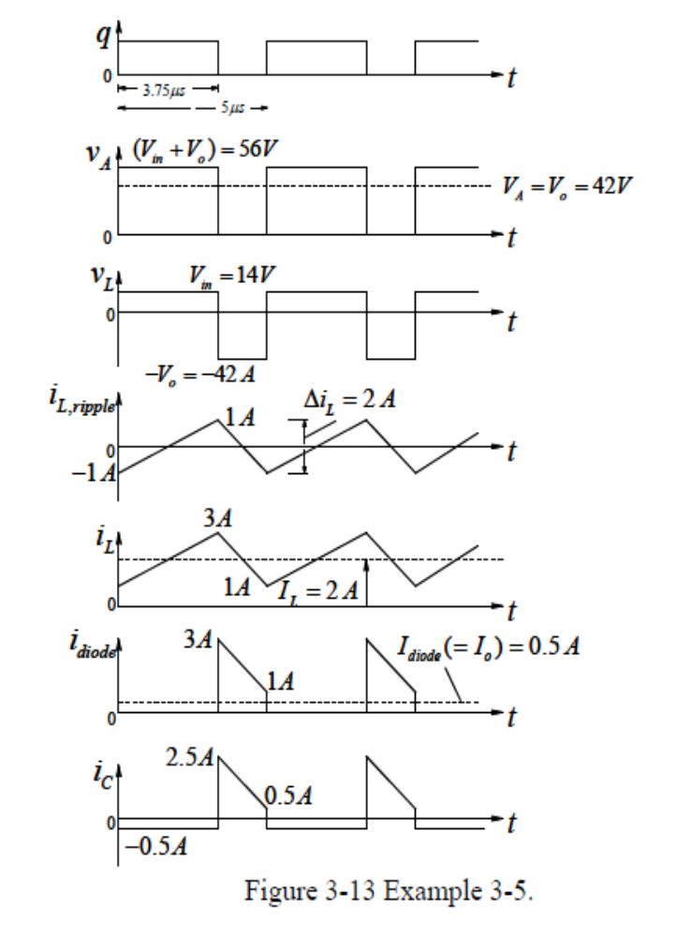
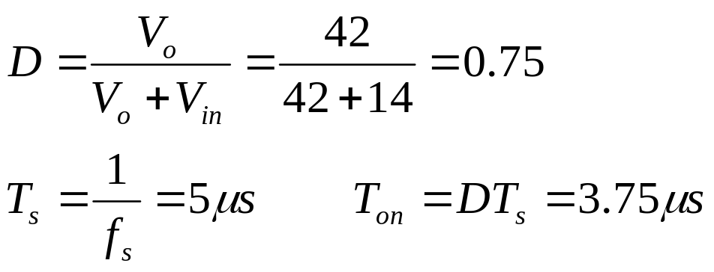
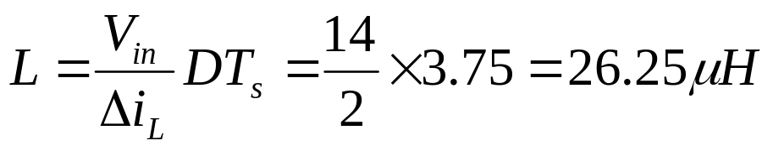
7-5 BUCK-BOOST CONVERTER
Solution
The inductor voltage v_{L} fluctuates between V_{in}=14V and −V_{o}=−42V .

Slide 16


7-5 BUCK-BOOST CONVERTER
When the transistor is on, the diode current is zero.
The capacitor current jumps to a value of 2.5 A and drops to （1− 0.5 ）= 0.5A .

Slide 17
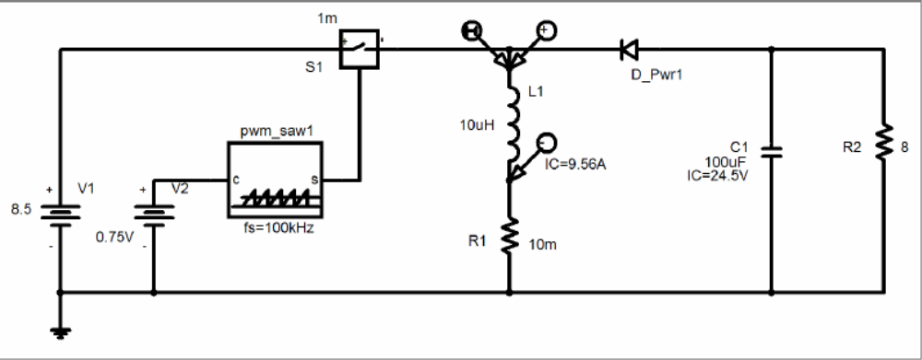
7-5 BUCK-BOOST CONVERTER
PSpice Modeling: C:\FirstCourse_PE_Book03\Buck-Boost_Switching.sch

Slide 18
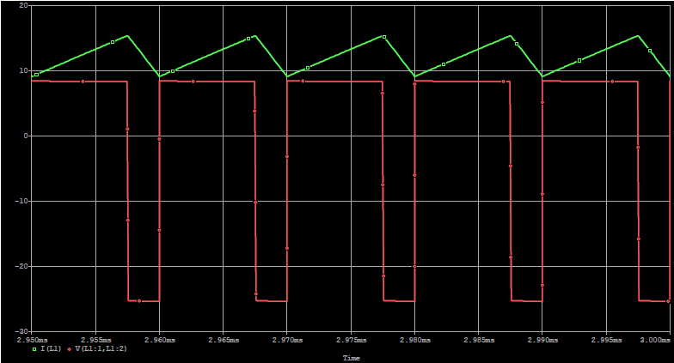
7-5 BUCK-BOOST CONVERTER
Simulation Results

Slide 19
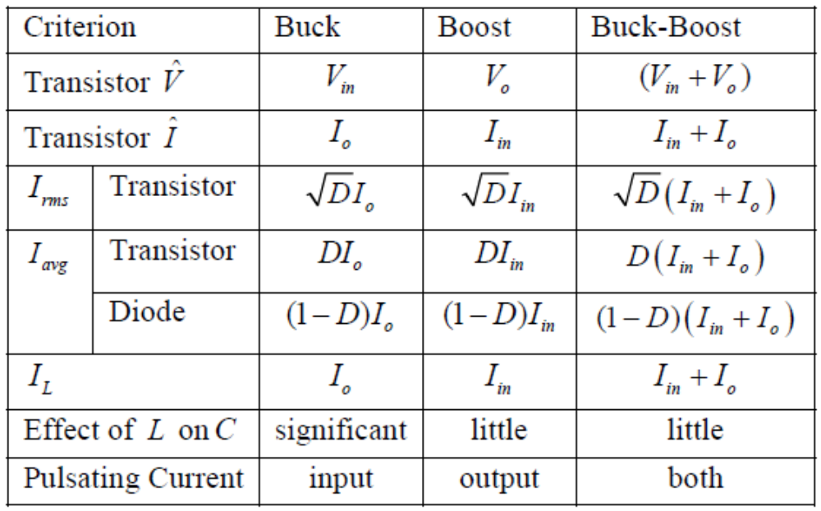
Comparison of the three converter topologies
Neglecting inductor ripple current
i_{in}
i_{o}
+
V_{in}
-
+
v_{oi}
-
L
+
V_{o}
-
+ v_{L} -
i_{in}
L
D
i_{o}
+
V_{in}
-
+
V
-
+
V_{o}
-
L
i_{in}
i_{o}
+
V_{in}
-
+
v_{L}
-
D
-
V_{o}
+
i_{L}
L

Slide 20
The Buck-Boost converter suffers from several additional stress. Therefore, it should be used only if both the Buck and the Boost capabilities are used. Otherwise, the Buck or the Boost converter should be used.

Slide 21
7-6 Cuk dc-dc Converter
7-6 Cuk dc-dc Converter
i_{L1}
v_{C1}
i_{L2}
+
V_{d}
-
L₁
L₂
+ C₁ -
-
V_{o}
+
+ v_{L1} -
T
- v_{L2} +
D
R
C₂
i_{T}
i_{D}
Similar to a buck-Boost converter, the cuk converter provides a negative-polarity output voltage with respect to the common terminal of the input voltage, and the output voltage can be either higher or lower than the input voltage.
unlike the buck-boost converter, both the input current and the output current are not pulsation.
In steady-state: V_{c1}=V_{d}+V_{o}

Slide 22
7-6 Cuk dc-dc Converter
U
G
0
t
7-6-1 continuous-conduction mode ☆
T
S
U
L1
U
d
0
t
1 Operation principle
−
(
U
−
U
)
T
S
c
1
d
(1) When the switch is on:
The input feeds energy to L₁, i_{L1}↑.
V_{c1} reverse biases the diode. i_{L1} and i_{L2} flow through the switch. C₁ discharge through the switch, transferring energy to the output and L₂ . i_{L2} ↑.
i
L1
(
=
0
I
L
I
d
)
t
t
on
t
off
U
L2
U
c
1
−
U
0
o
t
−
U
o
T
S
i
L2
(
=
0
I
L
I
o
)
t
+
+
L
1
-
-
-
L
2
+
U
U
C1
U
T
+
C1
-
U
U
U
L2
0
t
d
L
1
C
R
U
o
i
T
T
+
-
0
t

Slide 23
7-6 Cuk dc-dc Converter
U
G
0
t
T
S
(2) When the switch is off:
i_{L1} and i_{L2} flow through the diode. C₁ is charged by energy from both the input and L₁, i_{L1}↓. L₂ feeds the output, i_{L2} ↓.
U
L1
U
d
0
t
T
−
(
U
c
1
−
U
d
)
i
S
L1
(
=
0
I
L
I
d
)
t
t
on
t
off
U
L2
U
c
1
−
U
0
o
t
−
U
o
T
S
i
L2
(
=
0
I
L
I
o
)
t
+
+
L
1
-
-
L
2
+
+
U
U
C1
U
C1
T
U
-
-
U
L
U
L
C
R
U
t
d
1
2
o
0
+
i
-
D
T
0
t

Slide 24
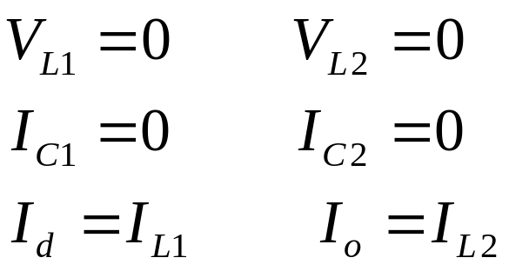
7-6 Cuk dc-dc Converter
2 Steady-state analysis:
In the dc steady state:
i_{L1}
v_{C1}
i_{L2}
+
V_{d}
-
L₁
L₂
+ C₁ -
-
V_{o}
+
+ v_{L1} -
T
- v_{L2} +
D
R
C₂
i_{T}
i_{D}

Slide 25
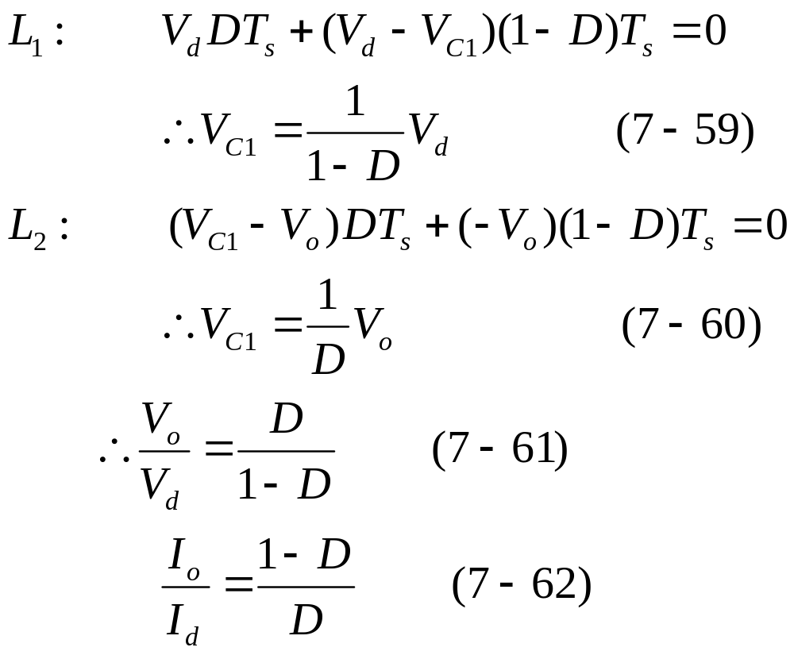
7-6 Cuk dc-dc Converter
U
G
0
t
T
S
U
L1
U
d
0
t
T
−
(
U
c
1
−
U
d
)
i
S
L1
(
=
0
I
L
I
d
)
t
t
on
t
off
U
L2
U
c
1
−
U
0
o
t
−
U
o
T
S
i
L2
(
=
0
I
L
I
o
)
t
U
U
C1
T
V_{o} can be controlled by varying the duty ratio D.
0
t
i
T
0
t

Slide 26
Example 7-3
In a Cuk converter operating at 50kHz, L₁=L₂=1mH and C₁=5µF. The output capacitor is sufficiently large to yield an essentially constant output voltage. Here V_{d}=10V and the output V_{o} is regulated to be constant at 5V. It is supplying 5W to a load. Assume ideal components. Calculate the percentage errors in assuming a constant voltage across C₁ or in assuming constant current i_{L1} and i_{L2}.
Solution
(a) If the voltage across C₁ is assumed to be constant, from Eq. 7-58: v_{C1}=V_{C1}=V_{d}+V_{o}=10+5=15V.
Initially, we will assume the current conduction to be continuous. Therefore, from Eq. 7-61: D/(1-D)=5/10, D=0.33.

Slide 27
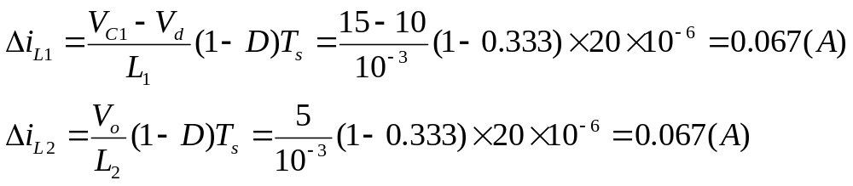
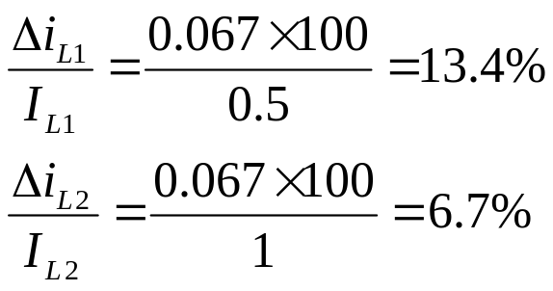
During the off interval:
At an output load of 5W: I_{o}=P_{o}/V_{o}=5/5=1A and I_{d}=0.5A.
Since Δi_{L1}<I_{d} (I_{L1}) and Δi_{L2}<I_{o} (I_{L2}), the mod of operation is continuous, as assumed earlier.
Therefore, the percentage errors in assuming constant I_{L1} and I_{L2} would be:
+
+
L
1
-
-
L
2
+
+
U
C1
U
-
-
U
L
U
L
C
R
U
d
1
2
o
+
-
D

Slide 28
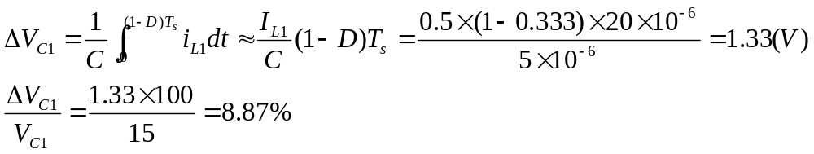
Solution
(b) If i_{L1} and i_{L2} are assumed to be constant, during the off interval:
+
+
L
1
-
-
L
2
+
+
U
C1
U
-
-
U
L
U
L
C
R
U
d
1
2
o
+
-
D

Slide 29
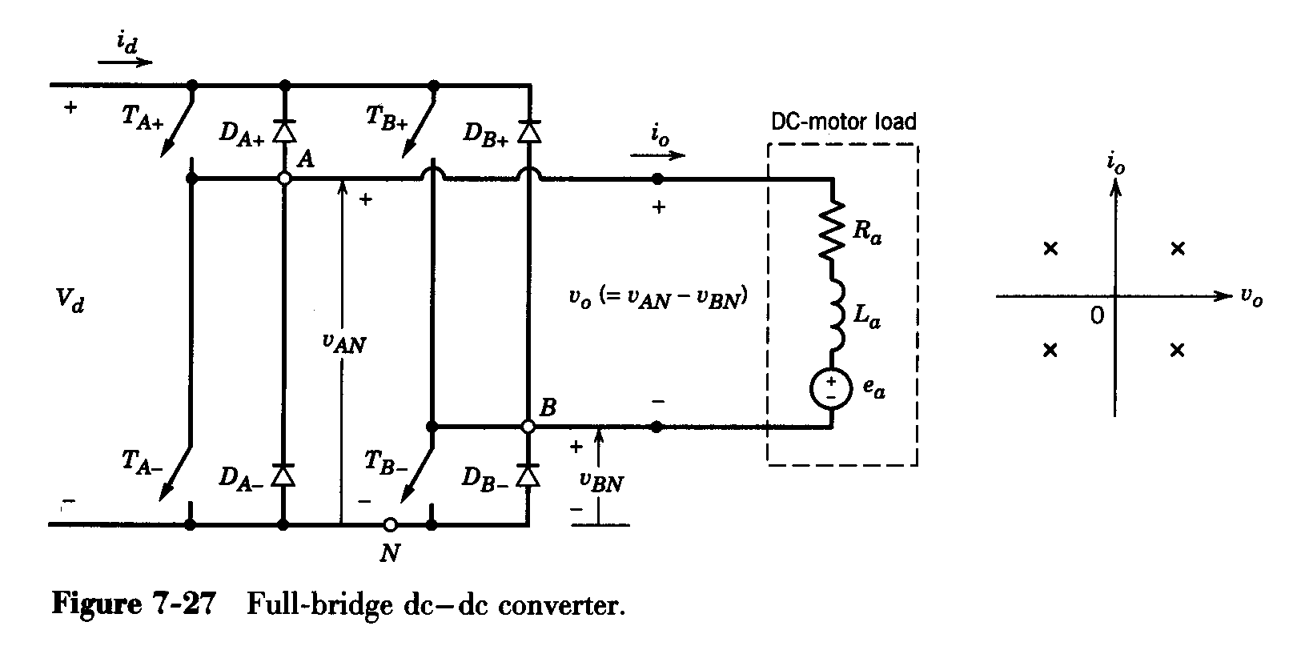
7-7 Full-Bridge dc-dc Converter
1 Analysis of full-bridge Converter ☆
The full-bridge converter consists of two legs, A and B. Each leg consists of two switches and their anti-parallel diodes.

Slide 30
Note:
when a switch is turned on , it may or may not conducts current, depending on the direction of i_{o}. if the switch conducts current, then it is in a conducting state（导电状态）, otherwise, in a on state（通态）.
the two switches are never on simultaneously. In practice, they are both off for a short time interval, known as blanking time（死区时间）, to avoid short circuiting of the dc input.

Slide 31
blanking time = dead time（死区时间） + turn off delay time
v_{control, bridge}
dead time
v_{control, T+}
blanking time
blanking time
collector current
v_{control, T-}
dead time
This blanking time is neglected in this Chapter, since the switch are assumed ideal.

Slide 32
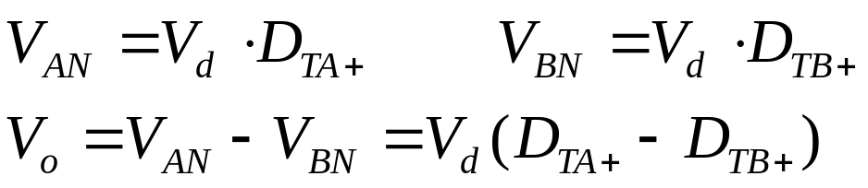
v_{AN} (v_{BN}, v_{o}) depends only on the switch status and is independent of the direction of i_{o}:
(a) v_{AN}=V_{d} (if T_{A+} is on and T_{A-} is off);
(b) v_{AN}=0 (if T_{A-} is on and T_{A+} is off).

Slide 33
Four quadrant operation is possible:
The input is a fixed-magnitude voltage V_{d}. The output voltage V_{o} can be controlled in magnitude as well as polarity. Similarly, the magnitude and the direction of the output current i_{o} can be controlled.
Unlike the single-switch converters, i_{o} does not become discontinuous at low values of I_{o}.

Slide 34
2 Main applications of full-bridge converter:
dc-to-dc conversion in dc motor drives (discussed in this Chapter)
dc-to-ac (sine-wave) conversion in single-phase uninterruptible ac power supplies (discussed in Chapter 8)
dc-to-ac (square-wave) (high intermediate frequency) conversion in switch-mode transformer isolated dc power supplies (discussed in Chapter 10)
ac-to-dc conversion in optimizing the Utility interface (discussed in Chapter 18)

Slide 35
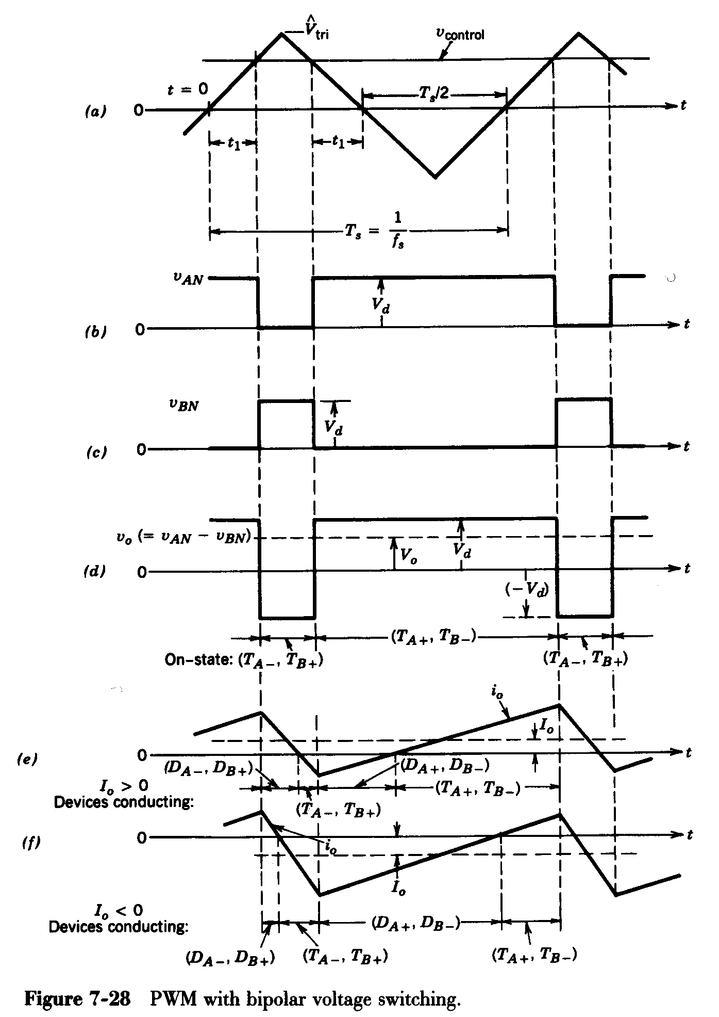
3 PWM switching strategies ☆
Bi-polar voltage switching
（双极性调制）
(T_{A+}, T_{B-}) and (T_{A-}, T_{B+}) are treated as two switch pairs (switches in each pair are turned on and off simultaneously).
One of the two switch pairs is always on. When v_{control}>v_{tri}, (T_{A+}, T_{B-}) are turned on; v_{control}<v_{tri}, (T_{A-}, T_{B+}) are turned on.

Slide 36
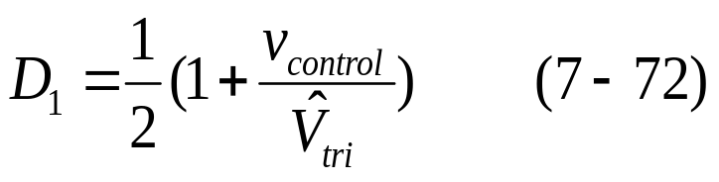
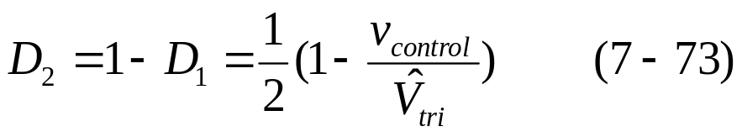
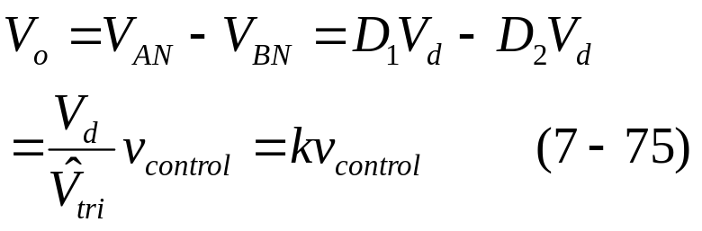
(T_{A+}, T_{B-}) duty ratio:
(T_{A-}, T_{B+}) duty ratio:
The average output voltage varies linearly with the input control single.

Slide 37
v_{o} jumps between +V_{d} and -V_{d}----bipolar voltage switching.
The average output current I_{o} can be either positive or negative, i_{o} during a cycle can be both positive and negative.

Slide 38
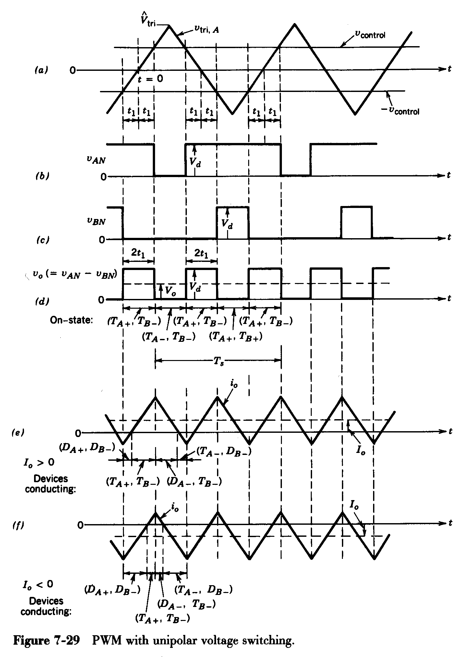
(2) Uni-polar voltage switching
（单极性调制）
The switches in each inverter leg are controlled independently on the other leg.
leg A controlled by v_{control}, leg B controlled by (-v_{control})
If v_{control}>v_{tri}, T_{A+} on; T_{A-} off
-v_{control}>v_{tri}, T_{B+} on; T_{B-} off

Slide 39
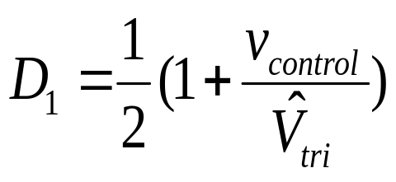
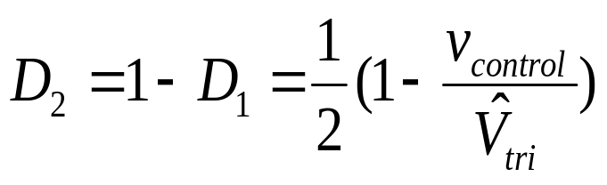
T_{A+} duty ratio:
T_{B+} duty ratio:

Slide 40
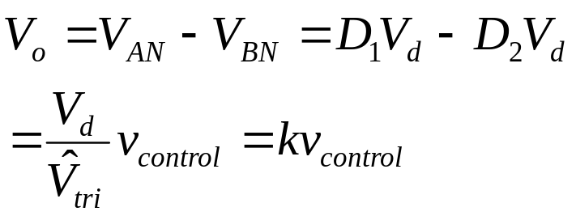
The average output voltage varies linearly with the input control single.
v_{o} jumps between +V_{d} (-V_{d}) and zero----unipolar voltage switching.
The “effective” switching frequency of the output voltage waveform is doubled.

Slide 41
The average output current I_{o} can be either positive or negative, i_{o} during a cycle can be both positive and negative.

Slide 42
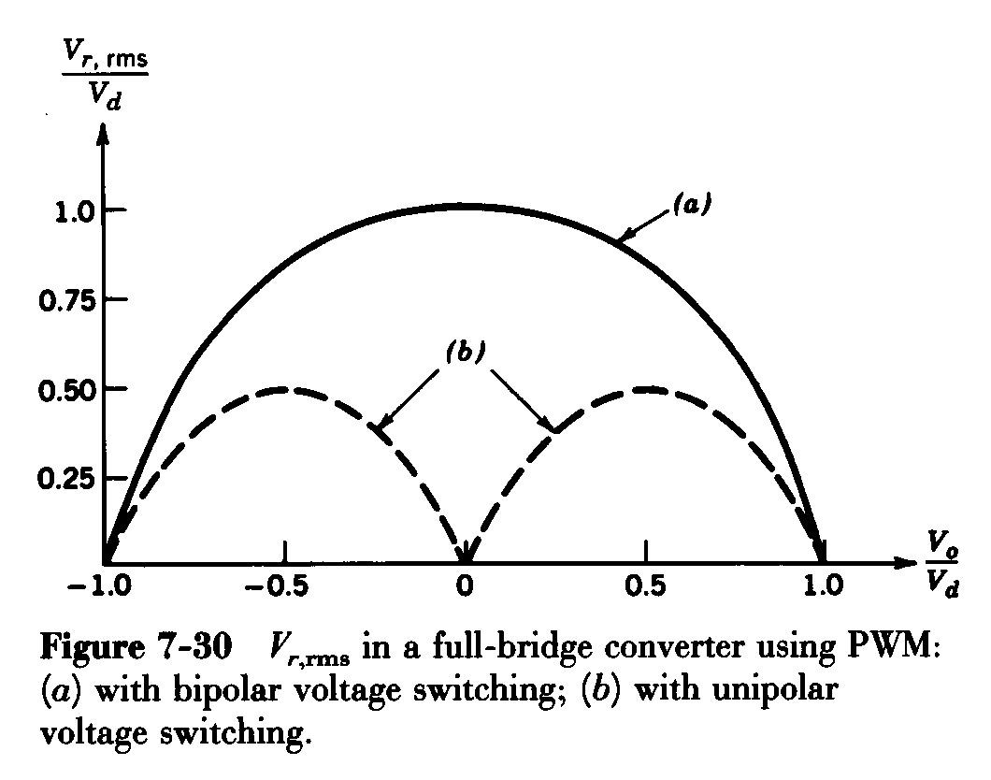
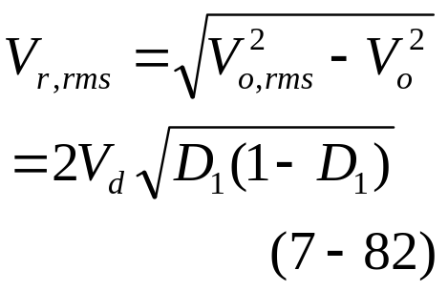
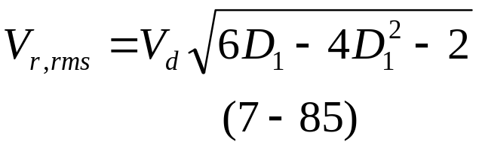
(3) Output Ripple V_{r,rms}
(a) bipolar:
(b) unipolar:

Slide 43
(4) Comparison of bipolar voltage switching to
unipolar voltage switching ☆
(a) Bipolar
Advantages: Bipolar PWM has a more simple circuit implementation. Only one control voltage and comparator needed in addition to the triangular wave generator.
Disadvantages: Bipolar PWM has half the ripple frequency compared to unipolar PWM and hence higher rms ripple component.

Slide 44
(4) Comparison of bipolar voltage switching to
unipolar voltage switching ☆
(b) Unipolar
Advantages: Unipolar PWM has twice the ripple frequency as bipolar PWM and hence lower rms ripple component.
Disadvantages: Unipolar PWM has more complicated circuitry because two control voltages are needed and thus two comparators, plus the triangle wave generator.

Slide 45
Example 7-4
In a full-bridge dc-dc converter, the input V_{d} is constant and the V_{r} in the output voltage is controlled by varying the duty ratio. Calculate the rms value of the ripple V_{r} in the output voltage as a function of the average V_{d} for
PWM with bipolar voltage switching and
(b) PWM with unipolar voltage switching.
Solution
(a) V_{o,rms}=V_{d}, V_{o}=(2D₁-1)V_{d}

Slide 46
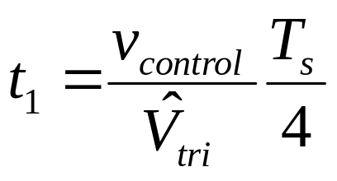
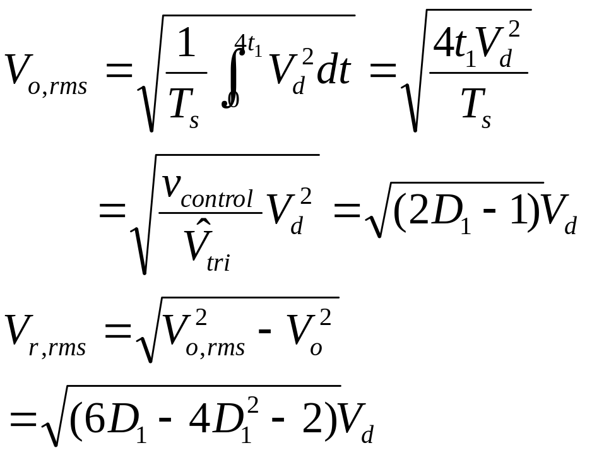
Solution
(b)

Slide 47
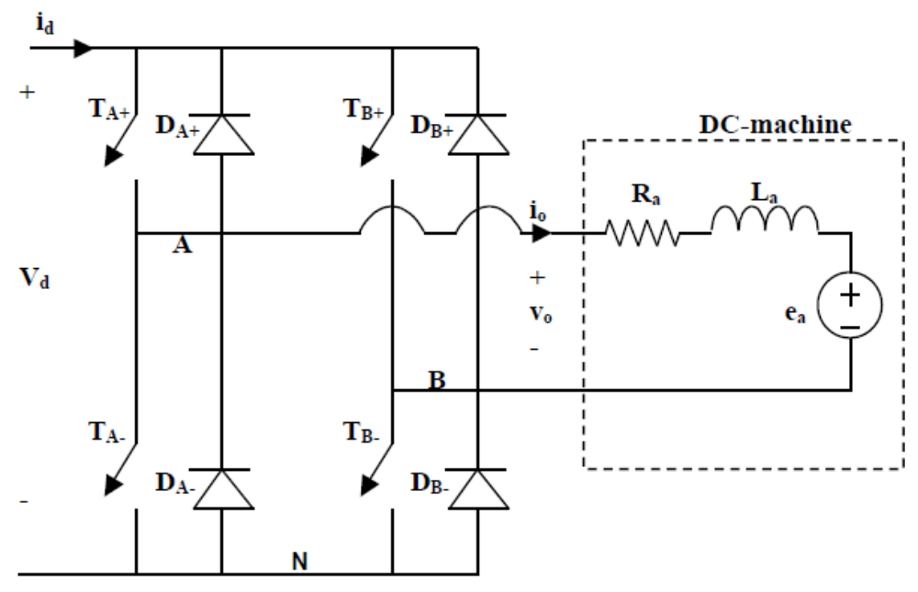
Example 7-5 Full bridge DC - DC converter
V_{d} = 250 V. Switching frequency is 30 kHz. The bridge is connected to a speed controlled dc machine. The armature inductance L_{a} = 0.2 mH. The armature resistance is negligible.

Slide 48
(a) The bridge may be controlled by the use of unipolar or bipolar PWM. Describe the advantages and disadvantages of these control algorithms.
Solution (a)
(a) Advantages:
Bipolar PWM has a more simple circuit implementation. Only one control voltage and comparator needed in addition to the triangular wave generator.
Unipolar PWM has twice the ripple frequency as bipolar PWM and hence lower rms ripple component.

Slide 49
Solution (a)
Disadvantages:
Bipolar PWM has half the ripple frequency compared to unipolar PWM and hence higher rms ripple component.
Unipolar PWM has more complicated circuitry because two control voltages are needed and thus two comparators, plus the triangle wave generator.

Slide 50

(b) The bridge is controlled to provide an average output voltage V_{o} = 200 V. Find the duty ratios D₁ and D₂ and the ripple frequency of the two control principles.
Sketch v_{o}(t) for the two control principles.
Solution (b)
(b) For both types of PWM, V_{o}=(2D₁ -1)V_{d} ;
Bipolar PWM ripple frequency = 30 kHz.
Unipolar PWM ripple frequency = 60 kHz
Waveforms for output voltage shown below.

Slide 51



Solution (b)
Waveforms for output voltage shown right.

Slide 52
(c) At a given speed, the back-emf E_{a} = 200 V. Unipolar PWM is used. The armature current I_{a} is 1 A, find the maximum and the minimum instantaneous armature current. Sketch the armature current i_{a}(t). Indicate which of the power semiconductors are conducting. Also sketch i_{d}(t).

Slide 53

Solution (c)
The source current i_{d}(t) equals the armature current i_{a}(t) when v_{a} >0.
When v_{a} = 0, i_{d} = 0 and armature current circulates through the upper or lower switches.
T_{A-}, D_{B-}
D_{A-}, T_{B-}

Slide 54

(d) As in Problem (c), with I_{a} = 20A.
Solution (d)
Maximum instantaneous armature current = 21.67 A.
Minimum instantaneous armature current = 18.33 A.
Instantaneous armature current never goes negative. D_{A+} and D_{B-} never conduct. Similarly T_{A-} and T_{B+} never conduct.
(D_{A-}, T_{B-})

Slide 55

(e) As in Problem (c), except bipolar PWM is used.
Solution (e)
D_{A+}, D_{B-}
D_{A-}, D_{B+}
Armature current, which is also equal to the source current i_{d}(t), is shown above.

Slide 56
7-8 dc-dc Converter Comparison
1 Comparison of operating regions ☆
The step-down, step-up, buck-boost, and Cuk converters in their basic forms are capable of transferring energy only in one direction. (operating in a single quadrant of the output voltage-current plane)
A full-bridge converters is capable of bidirectional power flow. (operating in four quadrant of the output voltage-current plane, this capability allows it to be as a dc-ac inverter)

Slide 57

A converter capable of bidirectional power flow. (operating in two quadrant of the output voltage-current plane)

Slide 58

2 Switch Utilization in DC-DC Converters
Consider continuous-conduction mode for all converters.
The switch peak voltage rating---V_{T}
The switch peak current rating---I_{T}
The switch power rating---P_{T}=V_{T}I_{T}
The rated output power---P_{o}=V_{o}I_{o}
Switch utilization = P_{o}/P_{T}
If at all possible, it is preferable to use either the step-down or the step-up converter from the switch utilization consideration.

Slide 59
Terms
steady state
Instantaneous power
Average Power
duty ratio
Ripple
bipolar voltage switching（
unipolar voltage switching
inverter

Slide 60
Review Questions
What is a dc chopper, or dc-dc converter?
What is the principle of operation of a step-down converter?
What is the principle of operation of a step-up converter?
What is the effect of load inductance on the load ripple current?
What is the effect of chopping frequency on the load ripple current?
At what duty cycle does the load ripple current become maximum?
What are the effects of chopping frequency on filter sizes?

Slide 61
Problem
Step-down converters
7-1 In a step-down converter, consider all components to be ideal. Let v_{o}=V_{o} be held constant at 5V by controlling the switch duty ratio D. calculate the minimum inductance L required to keep the converter operation in a continuous-conduction mode under all conditions if V_{d} is 10~40V, P_{o}>=5W, and f_{s}=50kHz.
i_{d}
i_{L}
i_{o}
+
V_{d}
-
+
v_{oi}
-
L
+
v_{o}=V_{o}
-
+ v_{L} -
R
C
(a)

Slide 62
Problem
7-2 Consider all components to be ideal. Assume V_{o}=5V, f_{s}=20kHz, L=1mH, and C=470µF. Calculate ΔV_{o} (peak-peak) if V_{d}=12.5V, and I_{o}=200mA.
7-3 In Problem 7-2, calculate the rms value of the ripple current through L and, hence, through C.

Slide 63
Problem
Step-up converters
7-7 In a step-up converter, consider all components to be ideal. Let V_{d} be 8~16V, V_{o}=24V (regulated), f_{s}=20kHz, and C=470µF. Calculate the minimum inductance L_{min} that will keep the converter operating in a continuous-conduction mode if P_{o}>=5W.
7-8 In a step-up converter, V_{d} =12V, V_{o}=24V, I_{o}=0.5A, L=150µH, C=470µF, and f_{s}=20kHz. Calculate ΔV_{o} (peak-peak).
7-9 In Problem 7-8, Calculate the rms value of the ripple in the diode current (which also flows through the capacitor).

Slide 64
Problem
Buck-boost converters
7-12 In a buck-boost converter, consider all components to be ideal. Let V_{d} be 8~40V, V_{o}=15V (regulated), f_{s}=20kHz, and C=470µF. Calculate the L_{min} that will keep the converter operating in a continuous-conduction mode if P_{o}>=2W.
Cuk converter
7-17 In the circuit of Example 7-3, calculate the rms current flowing through the capacitor C₁.

Slide 65
Problem
Full-bridge converters
7-20 Plot instantanuous power output p_{o}(t) and the average power P_{o}, corresponding to i_{o} in Figs. 7-28e and 7-28f.
7-21 Repeat Problem 7-20 for Figs. 7-29e and 7-29f.

Slide 66
Problem
7-22 In a full-bridge dc-dc converter using PWM bipolar voltage switching, analytically obtain the value of (V_{o}/V_{d}) which results in the maximum (peak-peak) ripple in the output current i_{o}. Calculate this ripple in terms of V_{d}, L_{a}, and f_{s}. Assume that R_{a} is negligible.

Slide 67
Problem
7-23 Repeat Problem 7-22 for a PWM unipolar voltage-switching scheme.

Slide 68

Problem
S7-1 The chopper below controls a dc machine with an armature inductance L_{a} =0.2 mH. The armature resistance can be neglected. The armature current is 5A. f_{s} = 30 kHz. D = 0.8

Slide 69
Problem
(a) The output voltage V_{o} equals 200V. Calculate the input voltage V_{d}.
(b) Find the ripple in the armature current.
(c) Calculate the maximum and the minimum value of the armature Current.
(d) Sketch the armature current i_{a}(t), and the dc current i_{d}(t).
(e) The load on the machine is reduced. Calculate I_{a} when the converter is on the boundary between continuous and
discontinuous mode.

Slide 70

Problem
S7-2 A step-down dc-dc converter like the one shown in Fig. 7-4a is to be analyzed. The input voltage V_{d} = 48 V,
The output filter inductance L = 0.1mH, Series resistor (with L) R = 0.2Ω, f_{s}=50kHz.
Assume in all calculations constant voltage over the series resistor R. The output capacitor C is large; assume no ripple in the output voltage. Rated output is 20V and 25A.

Slide 71
Problem
(a) Calculate rated output power.
(b) Calculate equivalent load resistance.
(c) Calculate duty ratio D for rated output. The voltage across the series resistor R must be taken into consideration.
(d) Keep this duty ratio constant and increase the load resistance, or reduce the load in W. Find the load current, voltage, watt and the equivalent load resistance R_{B} at the boundary to discontinuous conduction.
(e) Sketch the inductor current for this operation.

Slide 72
Problem
S7-3 Full bridge DC - DC converter
V_{d} = 250 V. Switching frequency is 30 kHz. The bridge is connected to a speed controlled dc machine. The armature inductance L_{a} = 0.2 mH. The armature resistance is negligible.

Slide 73
Problem
(a) The bridge may be controlled by the use of unipolar or bipolar PWM. Describe the advantages and disadvantages of these control algorithms.
(b) The bridge is controlled to provide an average output voltage V_{o} = 200 V. Find the duty ratios D₁ and D₂ and the ripple frequency of the two control principles.
Sketch v_{o}(t) for the two control principles.
At a given speed, the back-emf E_{a} = 200 V. Unipolar PWM is used.
(c) The armature current I_{a} is 1 A, find the maximum and the minimum instantaneous armature current. Sketch the armature current i_{a}(t). Indicate which of the power semiconductors are conducting. Also sketch i_{d}(t).
(d) As in Problem (c), with I_{a} = 20A.
(e) As in Problem (c), except bipolar PWM is used.

